Slide 1
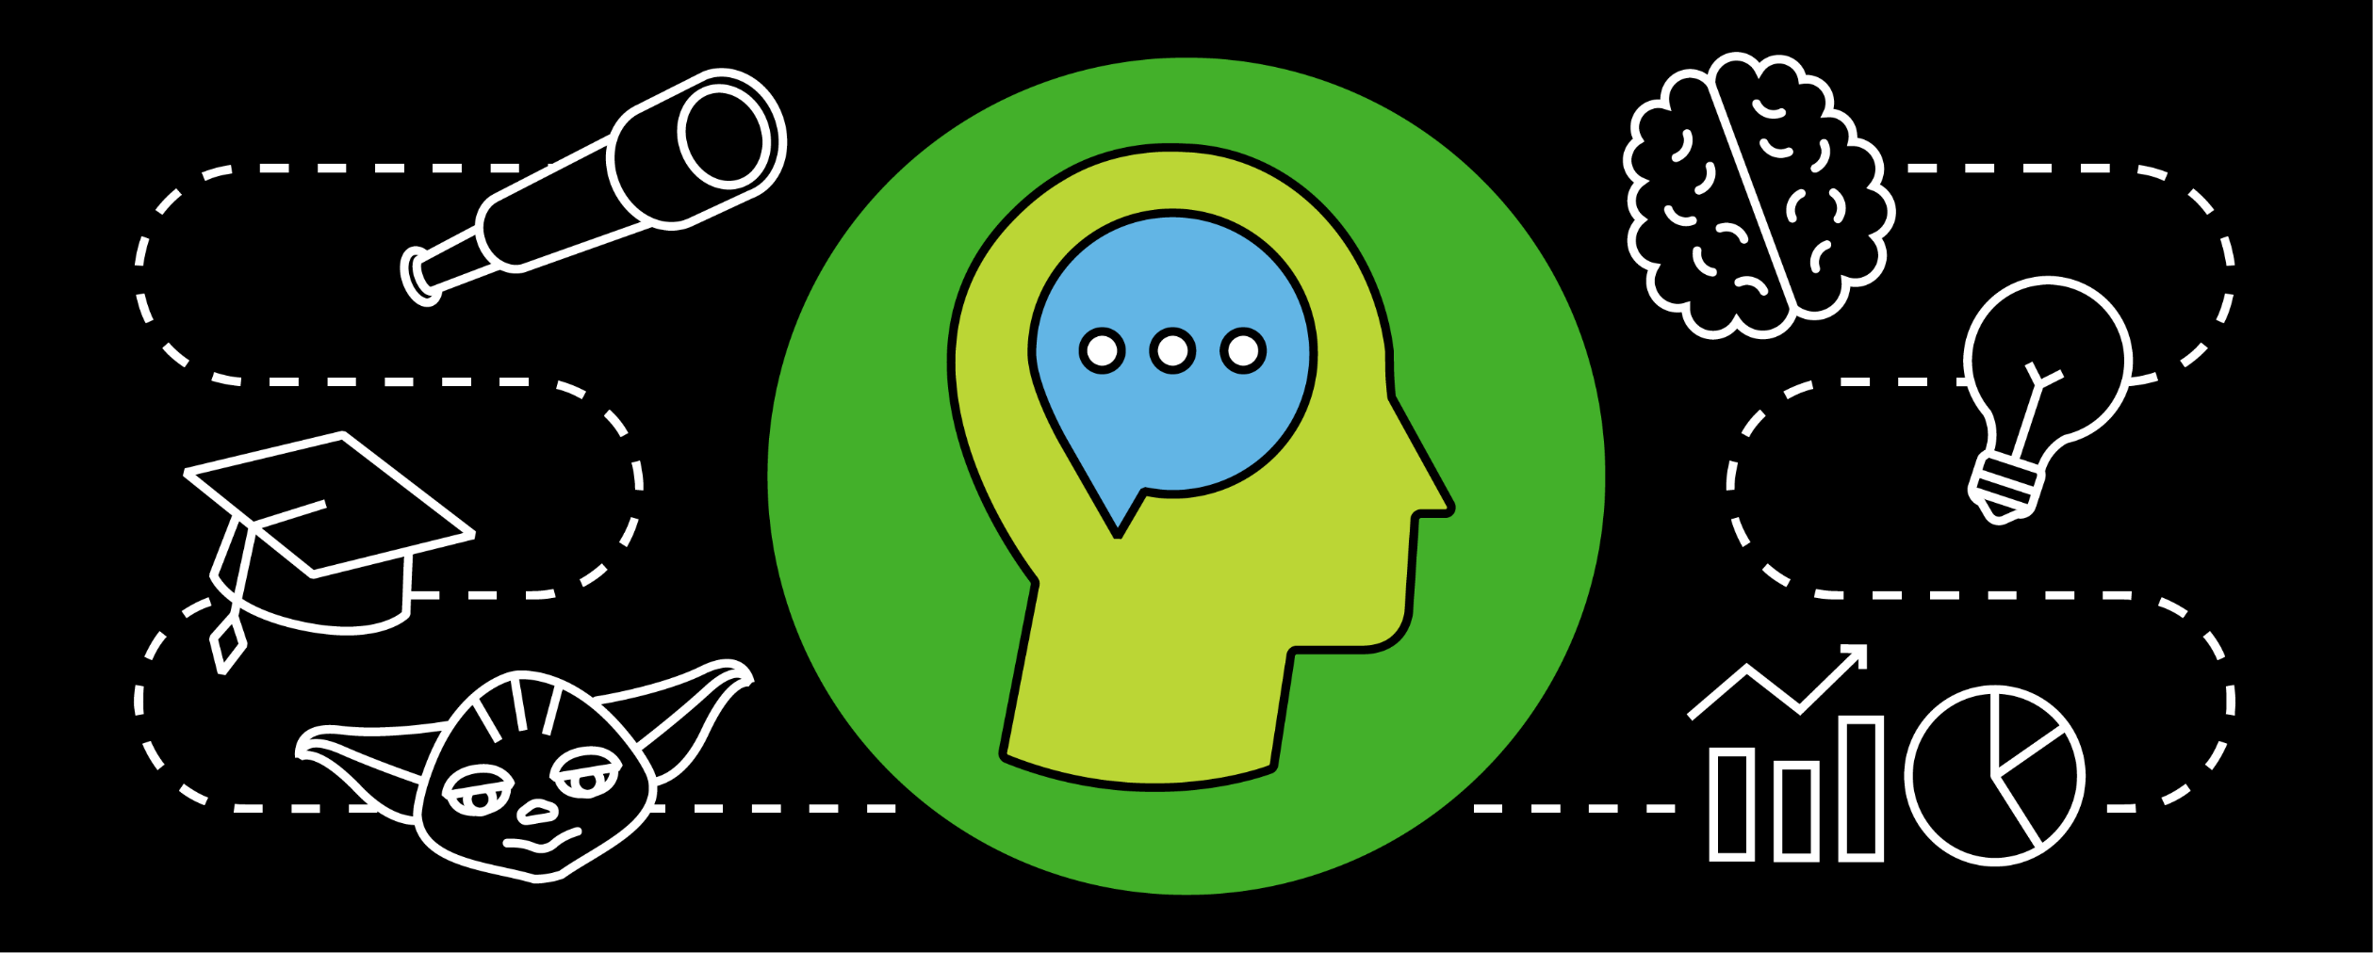

Technology Guild Program: Blockchain Guild
Mastery Program | Explorer Level Monthly Touchpoint
Emerging Tech and Tech Leadership | March 2021

Slide 2
Agenda
1
Learning Pathway Overview
2
Upcoming Deadlines
3
Test Yourself
4
Announcements
5
Q&A

Slide 3
Learning Pathway Overview

Slide 4
Explorer Learning Pathway: Overview
Introduction to Ethereum
We are here
Introduction to Corda
Blockchain Business Foundations
Kickoff – Guild Expectations
Blockchain Solution Architecture Checkpoint
Review & Final Exam
(90 Questions, 60 Minutes)
Introduction to Blockchain Architecture
Introduction to Hyperledger
Pre-Requisite
Day 1
Weeks 1-7
Week 7
Week 8
Week 9
Week 10
Week 11-12
Goal:
Explorers will learn foundational blockchain architecture principles and explore the differences between the most common vendors Deloitte works with. Courses will be taken online through the learning partner Blockchain Training Alliance.
Learning Requirement:
An approximately 12-week Blockchain Training Alliance license will be provided to you to take the required courses
You are expected to take roughly 40 course hours of interactive education with continuous feedback
This program lasts approximately 12 weeks, and you are expected to dedicate time on a weekly basis to the curriculum.
Role | Responsibility
Explorer | The Explorer is responsible for completing courses in an allotted timeframe and to escalate any issues to the Coordinator. A learning cohort will be assigned to each Explorer. Active participation is highly encouraged.
Coordinator | A Coordinator assigned to each cohort will meet with the student group bi-weekly to track progress and answer content questions.

Slide 5
Upcoming Deadlines

Slide 6
Explorer Learning Pathway: Mandatory Courses
You are expected to complete all coursework and quizzes/checkpoints by the assigned due date.
If you fall behind by 2 weeks worth of due dates, your seat will be cancelled and you will not be able to reapply for a year. Email the Guild mailbox in advance if you have any planned PTO that will prevent you from completing an assignment on time.
If your schedule does not allow you to make this commitment, please email the Guild mailbox ASAP confirming your inability to continue so that we may reassign your seat to others in the waitlist.
You MUST complete all coursework using a desktop. Coursework completed on a mobile device cannot be tracked.
Quizzes and the Solution Architecture Checkpoint must be passed with a grade of 80% or higher. The Explorer Final Exam is optional to complete the Explorer Program but required to move to the Apprentice program.
In order to be fast tracked for the Apprentice program, you must take the Explorer final exam by May 31, 2021.
Courses | Start Date | Due By
Explorer : Blockchain Architecture Training
Chapter 1: What is Blockchain | 2/12 | 2/22
Chapter 2: How Does Blockchain Work | 2/12 | 3/1
Chapter 3: Types of Blockchains | 2/12 | 3/8
Chapter 4: How is Blockchain Different Than What We Have Today | 2/12 | 3/15
Chapter 5: What Does a Blockchain Application Look Like? | 2/12 | 3/22
Chapter 6: How Do I Design and Develop a Blockchain Application? | 2/12 | 3/29
Chapter 7: How Do I test a Blockchain Application? | 2/12 | 4/5
Chapter 8: Use Cases for Blockchain | 2/12 | 4/12
Chapter 9: Blockchain Cybersecurity | 2/12 | 4/12
Explorer Blockchain Solution Architecture Checkpoint | 2/12 | 4/19
Explorer : Platform Overview
Chapter 10: Ethereum | 2/12 | 4/26
Chapter 11: Corda | 2/12 | 5/3
Chapter 12: Hyperledger | 2/12 | 5/10
Explorer Final Exam | 5/11 | 5/31

Slide 7
Progress Checkpoint: Test Yourself

Slide 8
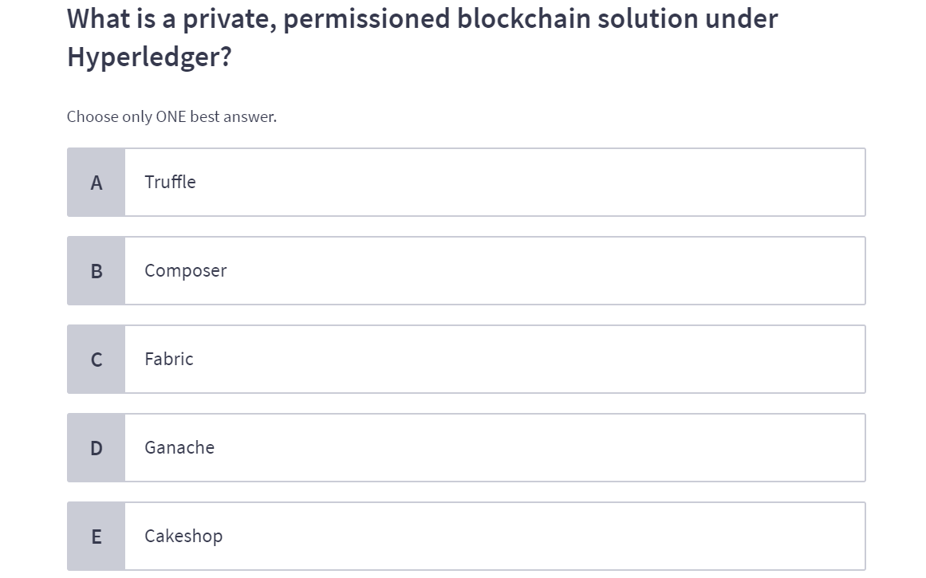
Test Yourself: Question 1

Slide 9
Test Yourself: Question 1

Slide 10
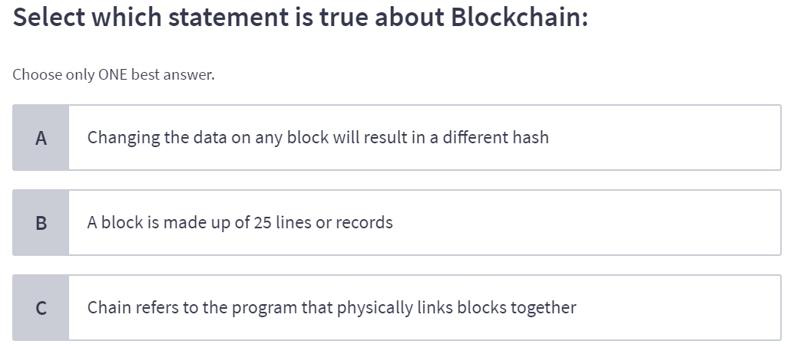
Test Yourself: Question 2

Slide 11
Test Yourself: Question 2

Slide 12
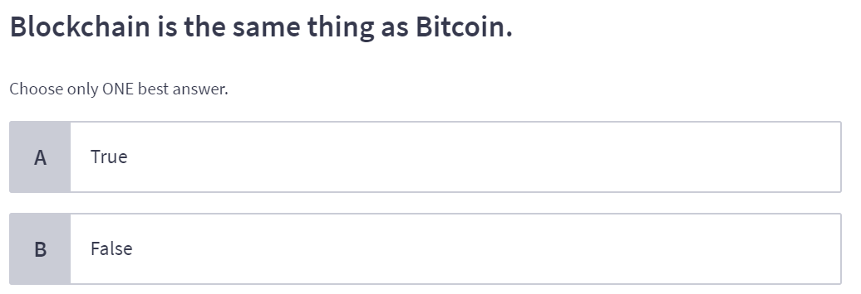
Test Yourself: Question 3

Slide 13
Test Yourself: Question 3

Slide 14
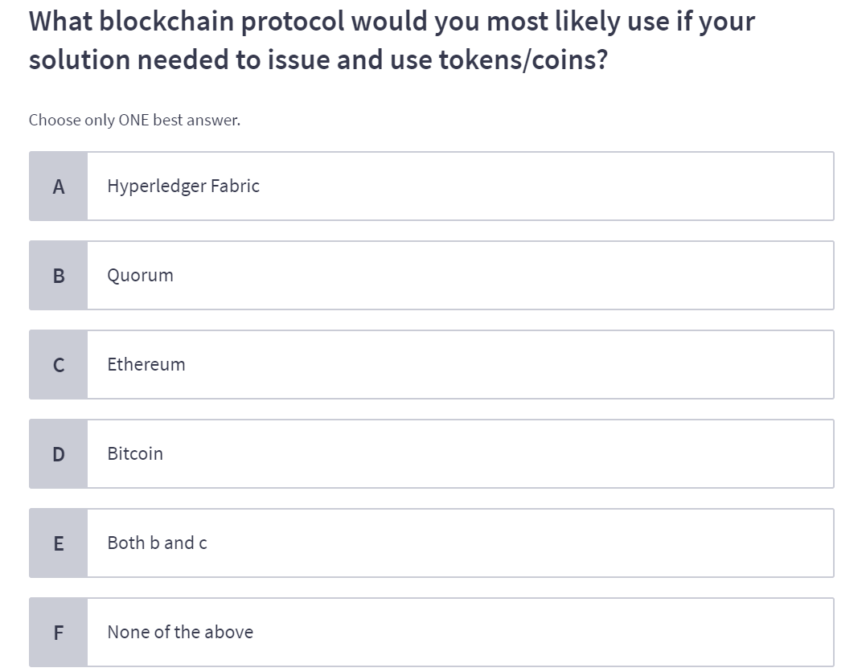
Test Yourself: Question 4

Slide 15
Test Yourself: Question 4

Slide 16
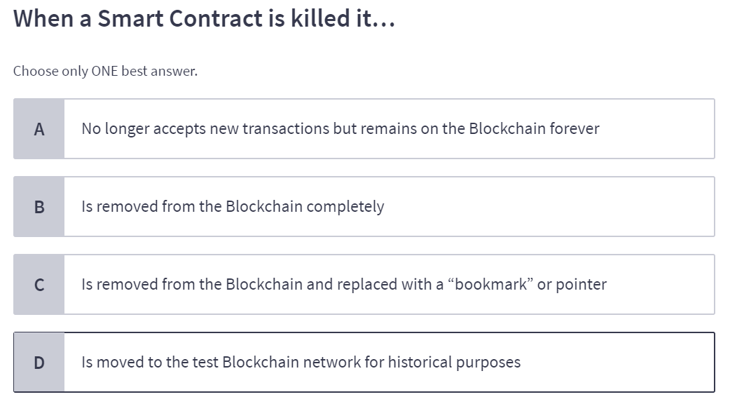
Test Yourself: Question 5

Slide 17
Test Yourself: Question 5

Slide 18
Announcements

Slide 19
General Explorer Announcements
Take a Quick Quiz!
Share your knowledge through completing the quiz here by April 5th!

Slide 20
Get involved with other guild opportunities!
Other Blockchain Insights
Stay up-to-date on blockchain industry insights! You’re a part of an innovative, global community, so take advantage of all the resources out there.
Some industry insights published recently:
Article: How Blockchain Can Change Banking
Video: Can Blockchain Enable Identity Management?
Whitepaper: Realizing the Potential of Blockchain
Deloitte’s Blockchain KX Site

Slide 21
Q&A

